Slide 1


Facebook Ad Benchmarking Tool
Edwin Tam Wei Ching | - | A0178396J
Lin Jun Liang | - | A0178295M

Slide 2
Here’s a question

Slide 3
Which of these Facebook Advertisements perform better?

Slide 4
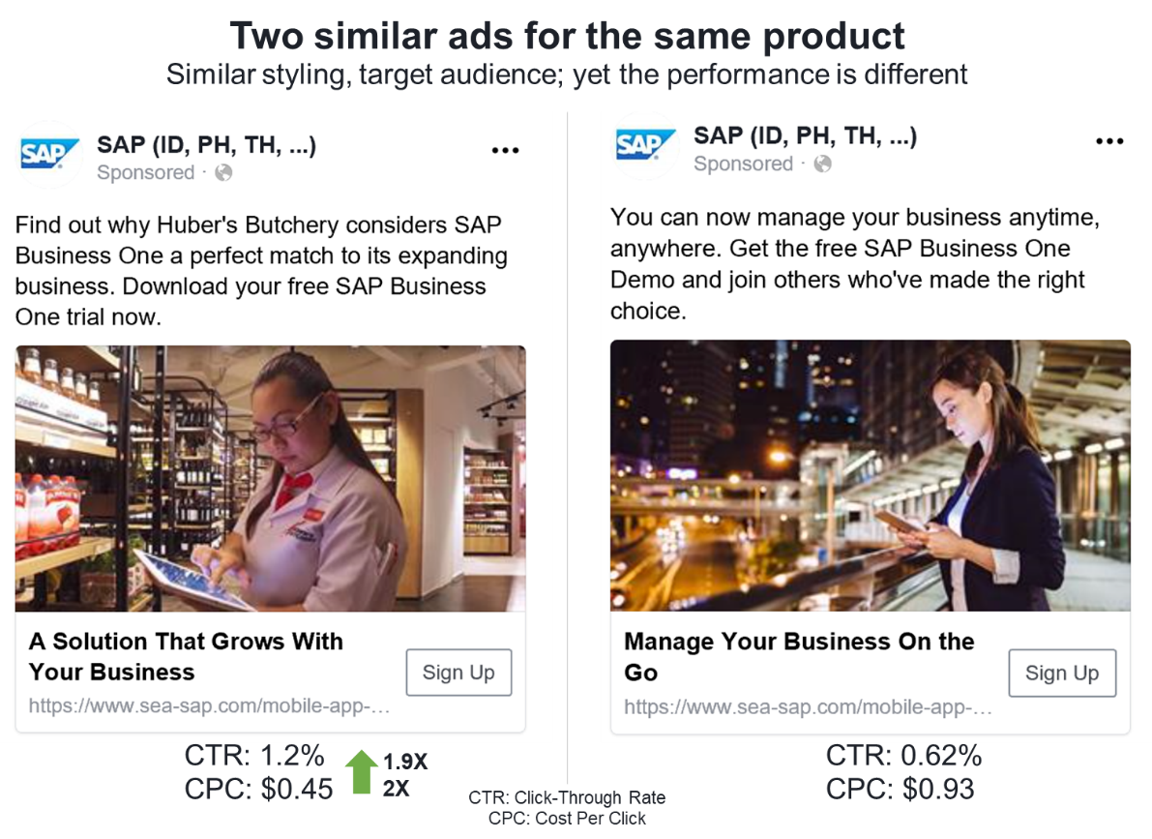
Which of these Facebook Advertisements perform better?

Slide 5
Which of these Facebook Advertisements perform better?
Similar styling, target audience, similar ads – yet the performance is different

Slide 6

Which one so that I won’t waste $?
Limited $
Maximal CTR

Slide 7
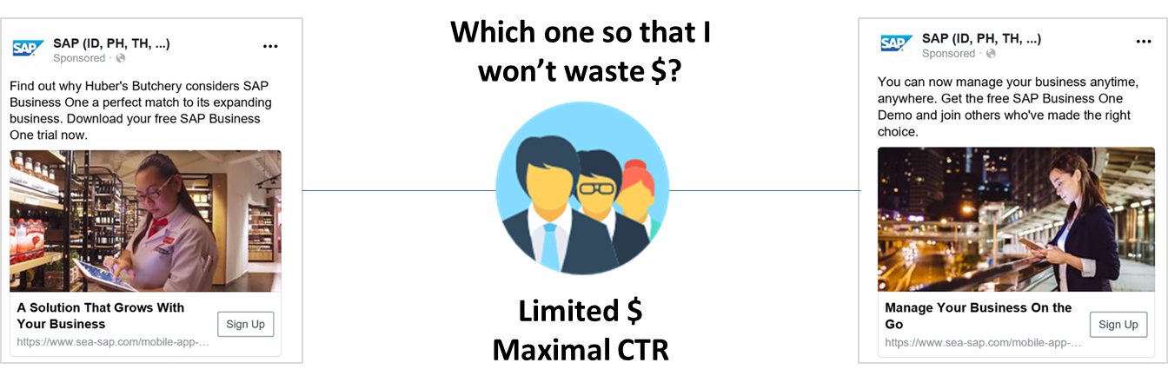
Predict a social media advertisement’s click-throughs before it goes live

Slide 8
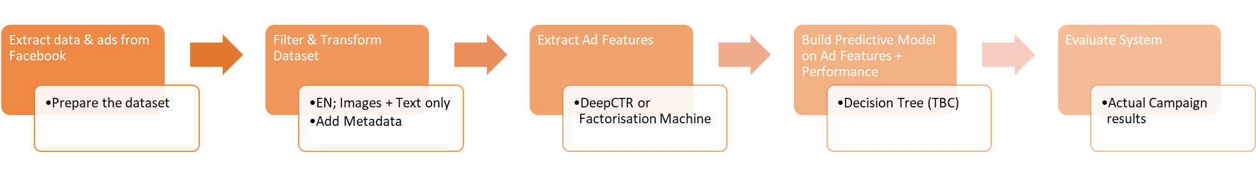
Here’s how
SVM
Neural Network

Slide 9
SVM
Neural Network
Extract & transform past data from social media platforms
Ads and ad performance data is contained on social media platforms. They are our data source for this system.
Extract ad features for prediction use
“Recognize" image elements and text in the ad. Image elements could be people, car, etc. These elements are then used – in conjunction with ad performance data – to train the system and predict on new ads.
Predict a close enough Cost-Per-Click (CPC) / Click-Through-Rate (CTR)
The final output of this system. We define “close enough” as 70% to 80% of the actual CPC/CTR

Slide 10
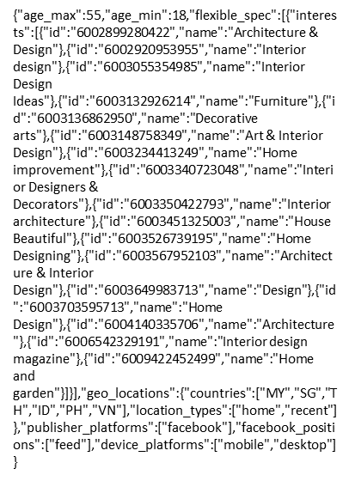
SVM
Neural Network
Extract & transform past data from social media platforms
Extract ad features for prediction use
Predict a close enough Cost-Per-Click (CPC) / Click-Through-Rate (CTR)
CTR: 1.2%
CPC: $0.45
Ad
Targeting parameters

Slide 11
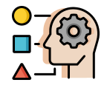


Context & Knowledge
Roles, Systems, & Functions
Intelligence & Technical Architecture

Slide 12
Context & Knowledge
Roles, Systems, & Functions
Intelligence & Technical Architecture

Slide 13
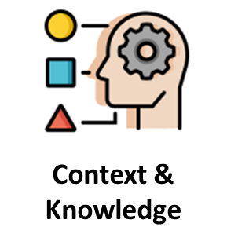
What goes into making and launching a Facebook ad Indicated by repeated expositions of “the ad must have a headline”, “we must also take care of targeting” etc.; as well as our exploratory data analysis of Facebook ad data.
The relationships are largely “part-of”; hence we will model this knowledge as a composition tree.
Why an ad performs poorly (or well) Not surprising considering that social media ad optimization is largely based on trial and error with some reverse-engineering taking place. In this case, the marketers are looking to hypothesize causes of ad performance.
Hence, we will model this knowledge as a cause tree.

Slide 14
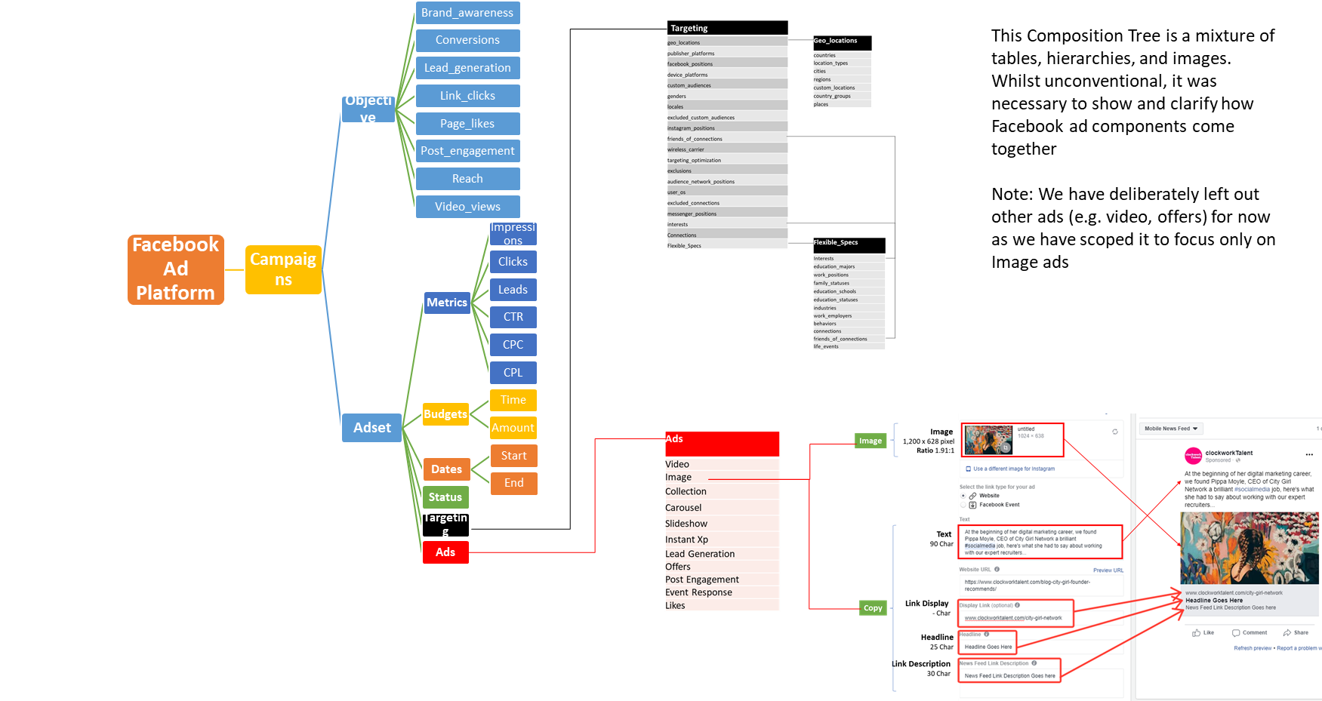
What goes into making and launching a Facebook ad

Slide 15
What goes into making and launching a Facebook ad

Slide 16
Why an ad performs poorly (or well)
Ad CTR is below KPI
Budget has run out prematurely
Going after too large audience segment
Campaign budget cadence was not followed
Not reaching the right audience
Targeting wrong work position
Audience is uninterested
Message is irrelevant
Targeting wrong location
Targeting wrong demographics
Age range is too broad or narrow
Wrong age range
Wrong city or state
Too broad location (i.e. SEA instead of SG)
Too many broad interests
Irrelevant Interests or hobby targeting
Too broad (i.e. manager)
Function is not included
Targeting wrong Interests
Too narrow (i.e. specialist roles) with too little size
Image does not stand out
Copy is irrelevant
Bad localisation
Budget is too low
Unaware of cultural nuances
Saying too many things at once
Tries to be too smart
Unclear action
Same look as competitor ads
User does not understand the image
Does not fit users’ psychological state
Unclear value proposition
CTA is buried
Literal translation
Legend
Observation
Causes of poor ad performance is largely due to Budget, Targeting, and Ad Creatives.
The Cause Tree (as it is laid out now) suggests that there is just 1 root cause, but in reality there are likely to be combinations of causes across budget, targeting, and creatives.
Caused by
Reason

Slide 17
Context & Knowledge
Roles, Systems, & Functions
Intelligence & Technical Architecture

Slide 18


Systems Functions
Roles, Systems, & Functions
User | Role | Frequency of Use | Security/Access Features Used | Additional Notes
Digital media planners / in-house marketing executive | Plans & Executes ad campaigns for brand | At least 1 per day | Upload Ads + parameters Get CTR or CPC prediction | Future versions: ad improvement pointers, current position in benchmarks
System | Advisor that helps users forecast ad performance | NA | Access Facebook Ad manager Access historical database | Future versions: automatic link up with social media platforms; recommendation engine

Slide 19
Systems Functions
Roles, Systems, & Functions
“I can input my ad image so that I get to know the potential CTR and CPC for the ad image I provided”
Allow the user to upload the image
Produce a prediction result based on the upload

Slide 20
Systems Functions
Roles, Systems, & Functions
“I can input my ad image so that I get to know the potential CTR and CPC for the ad image I provided”
Allow the user to upload the image
Produce a prediction result based on the upload
“I can add on more images with actual campaign performance so that I can get better prediction”
Allow user to enter the location of the image and the actual performance
Extract features from new images provided by user
Use new features to re-train existing models
New models to be redeployed

Slide 21

Systems Functions
Roles, Systems, & Functions
“I can input my ad image so that I get to know the potential CTR and CPC for the ad image I provided”
Allow the user to upload the image
Produce a prediction result based on the upload
“I can add on more images with actual campaign performance so that I can get better prediction”
Allow user to enter the location of the image and the actual performance
Extract features from new images provided by user
Use new features to re-train existing models
New models to be redeployed
“I want to bulk upload campaign performance data from Facebook ads manager so that I don’t have to manually do so”
Connect to cloud storage and locate new data daily
Extract features from new images provided by user
Use new features to re-train existing models
New models to be redeployed
In-house system scrapes data from Facebook and upload the information into our storage

Slide 22
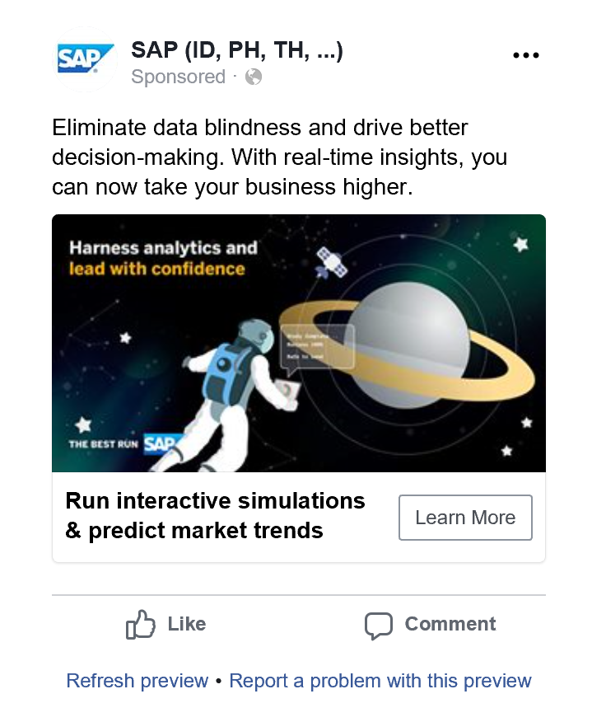

Systems Overview
Roles, Systems, & Functions
1
Users submit their ad images and ad text into the system
User action
System action

Slide 23

Systems Overview
Roles, Systems, & Functions
Facebook Ad Benchmarking System
CTR: 1.2%
CPC: $0.40
1
Users submit their ad images and ad text into the system
Produce CTR/CPC prediction (current phase)
2
User action
System action

Slide 24
Systems Overview
Roles, Systems, & Functions
Facebook Ad Benchmarking System
CTR: 1.2%
CPC: $0.40
1
Users submit their ad images and ad text into the system
Produce CTR/CPC prediction (current phase)
2
Ad Benchmarking Database
3
Modify ad if necessary.
Store results into Facebook Ad Benchmarking Database (Phase 2)
3
User action
System action

Slide 25

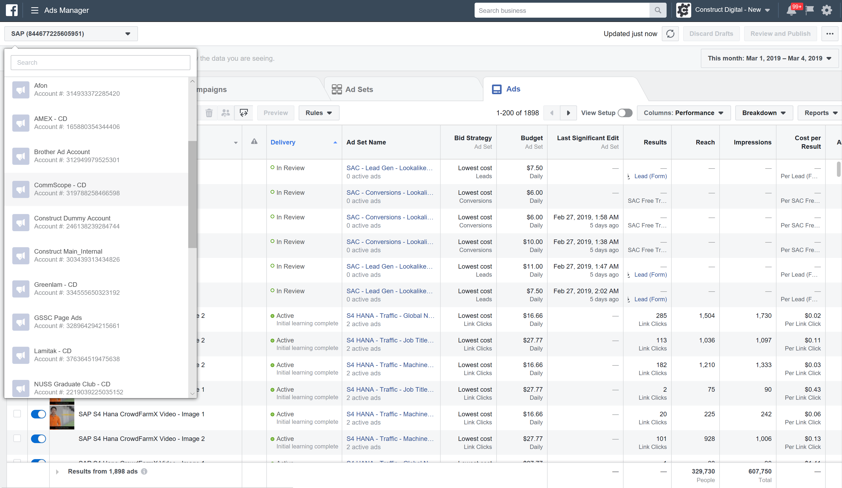
Systems Overview
Roles, Systems, & Functions
4
System pulls actual Ad performance into database to retrain model (Phase 2/ Future improvement)
Facebook Ad Benchmarking System
CTR: 1.2%
CPC: $0.40
1
Users submit their ad images and ad text into the system
4
Upload into Facebook ads manager for campaign launch
2
Produce CTR/CPC prediction (current phase)
Ad Benchmarking Database
3
Modify ad if necessary.
Store results into Facebook Ad Benchmarking Database (Phase 2)
3
User action
Ad performance is tracked on Facebook Ad Manager
4
System action

Slide 26
Context & Knowledge
Roles, Systems, & Functions
Intelligence & Technical Architecture

Slide 27
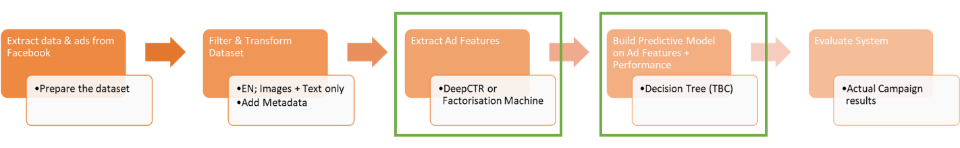
Image Feature Extraction & Performance Prediction
Intelligence & Technical Architecture
SVM
Neural Network

Slide 28



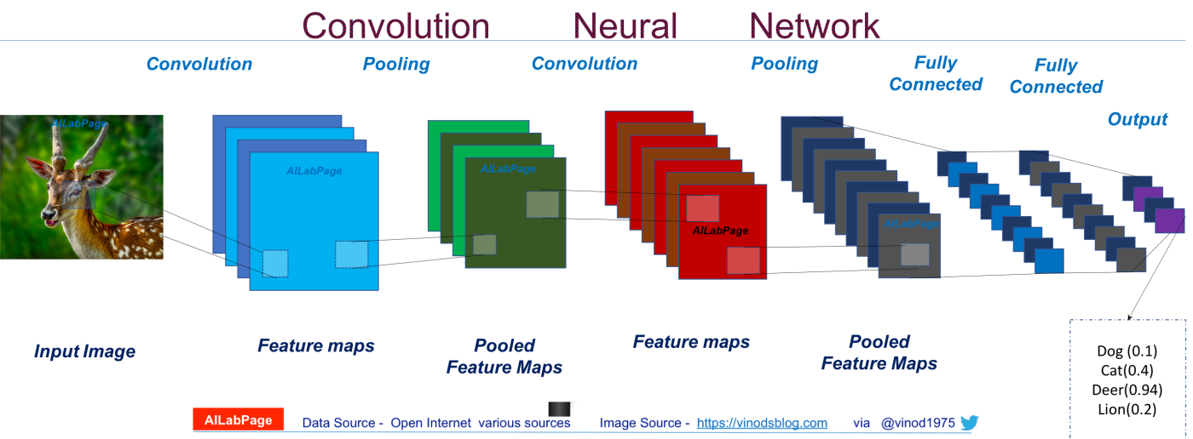
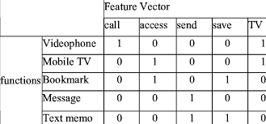
Image Feature Extraction & Performance Prediction
Intelligence & Technical Architecture
image of fixed size (1,200 X 628 px; padded if necessary)
Feature vector of the image
Pass image through Convolutional Network architecture based on 17 convolution layers. The first convolution layer uses 5 X 5 convolution kernels. Following first layer, there are four groups, and each has four layers with 3 X 3 kernels.
The network is pre-trained on a training dataset of category labels
Source: Deep CTR Prediction in Display Advertising
Note: We would like to do this in an unsupervised learning way in the future as we don’t want to limit the things in the ads

Slide 29
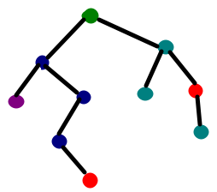
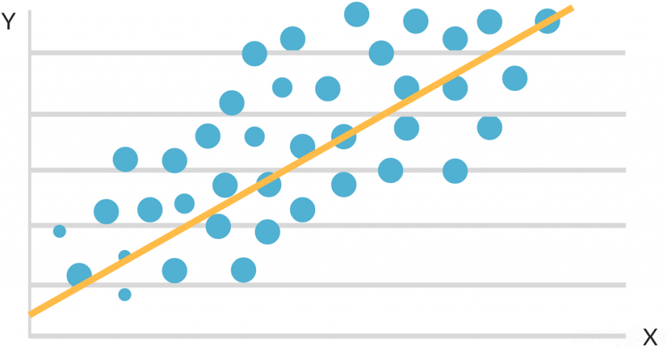
Image Feature Extraction & Performance Prediction
Intelligence & Technical Architecture
SVM
Neural Network
CTR: 1.2%
CPC: $0.45
Targeting Parameters
linear regressor.
Feature vector of image + Basic feature vector
Source: Deep CTR Prediction in Display Advertising

Slide 30




Technical Architecture
Intelligence & Technical Architecture
Data Sources
Data ingestions Sub-system
In-house system
Extract
Ingest
Store
Facebook Ad
Platform
Blob
Storage

Slide 31




Technical Architecture
Intelligence & Technical Architecture
Data Sources
Analytics
Data ingestions Sub-system
In-house system
Data Modelling Sub-system
Extract
Ingest
Store
Prep & Train
Model & Serve
Facebook Ad
Platform
Blob
Storage
Image recognition
engine
Model simulation engine

Slide 32


Technical Architecture
Intelligence & Technical Architecture
Data Sources
Analytics
User Access
Data ingestions Sub-system
In-house system
Data Modelling Sub-system
Extract
Ingest
Store
Prep & Train
Model & Serve
Facebook Ad
Platform
Ad Benchmarking
Tool
Marketers
Blob
Storage
Image recognition
engine
Model simulation engine

Slide 33
Technical Architecture
Intelligence & Technical Architecture
Data Sources
Analytics
User Access
Data ingestions Sub-system
In-house system
Data Modelling Sub-system
Extract
Ingest
Store
Prep & Train
Model & Serve
Facebook Ad
Platform
Ad Benchmarking
Tool
Marketers
Blob
Storage
Image recognition
engine
Model simulation engine

Slide 34
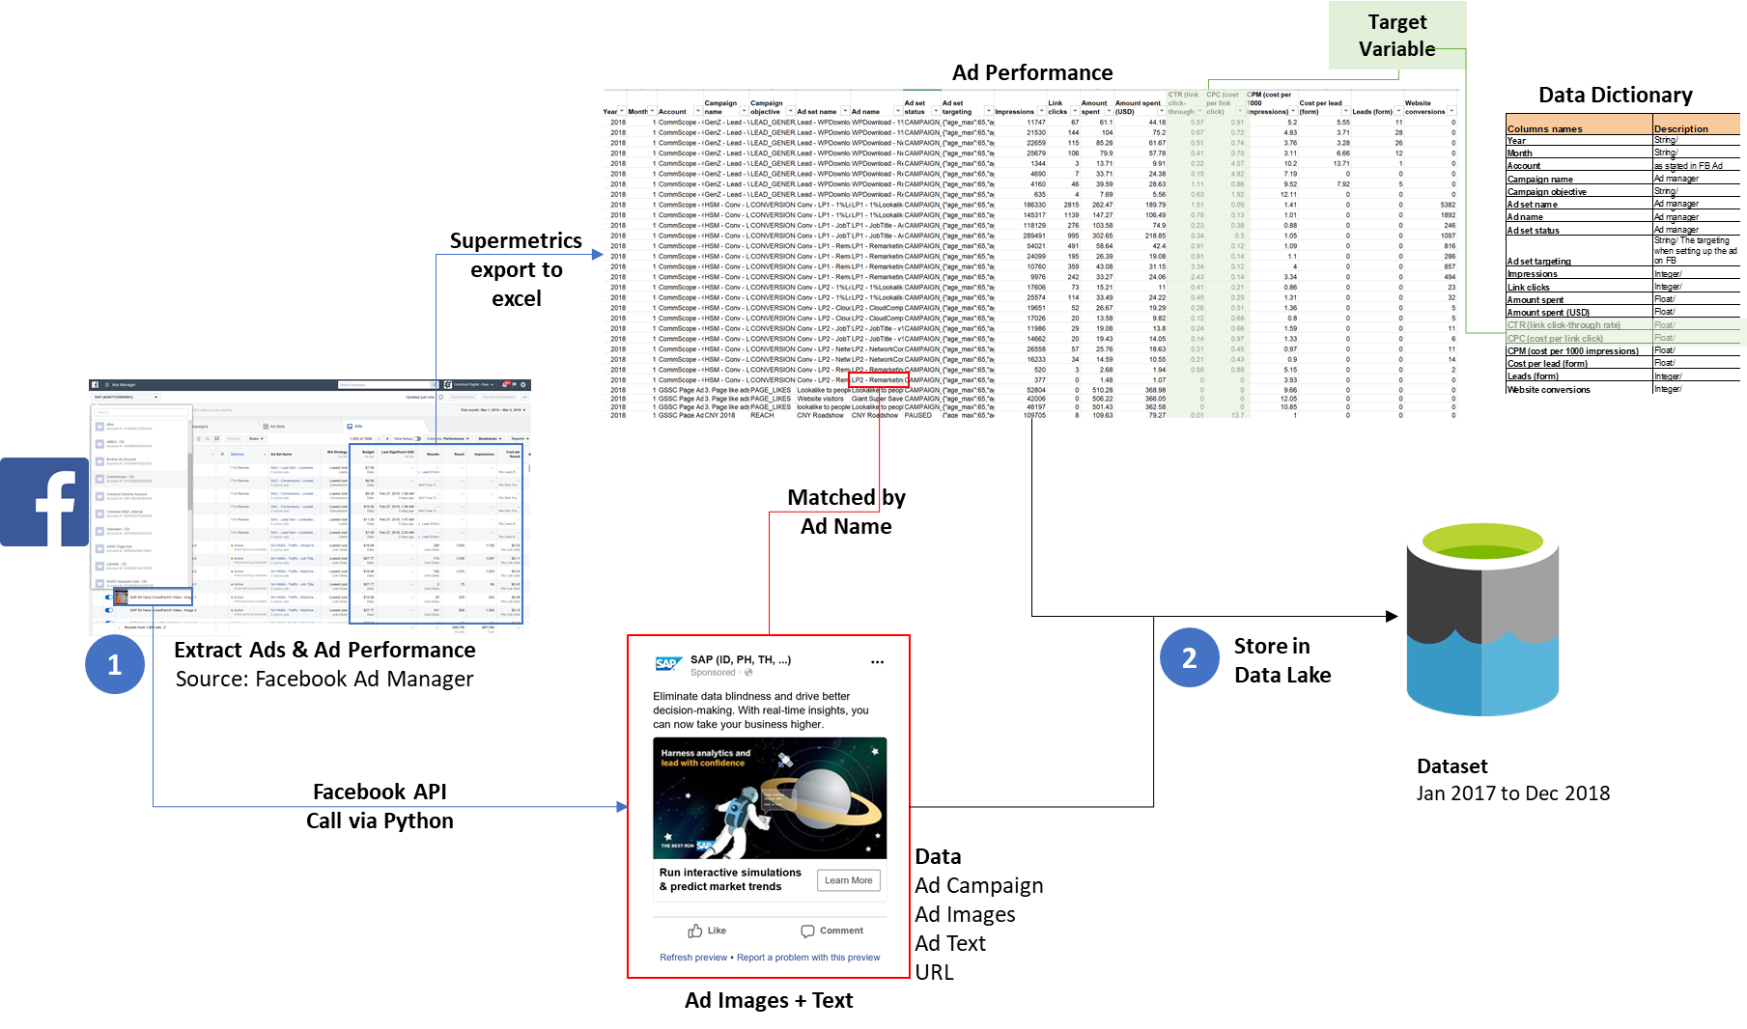
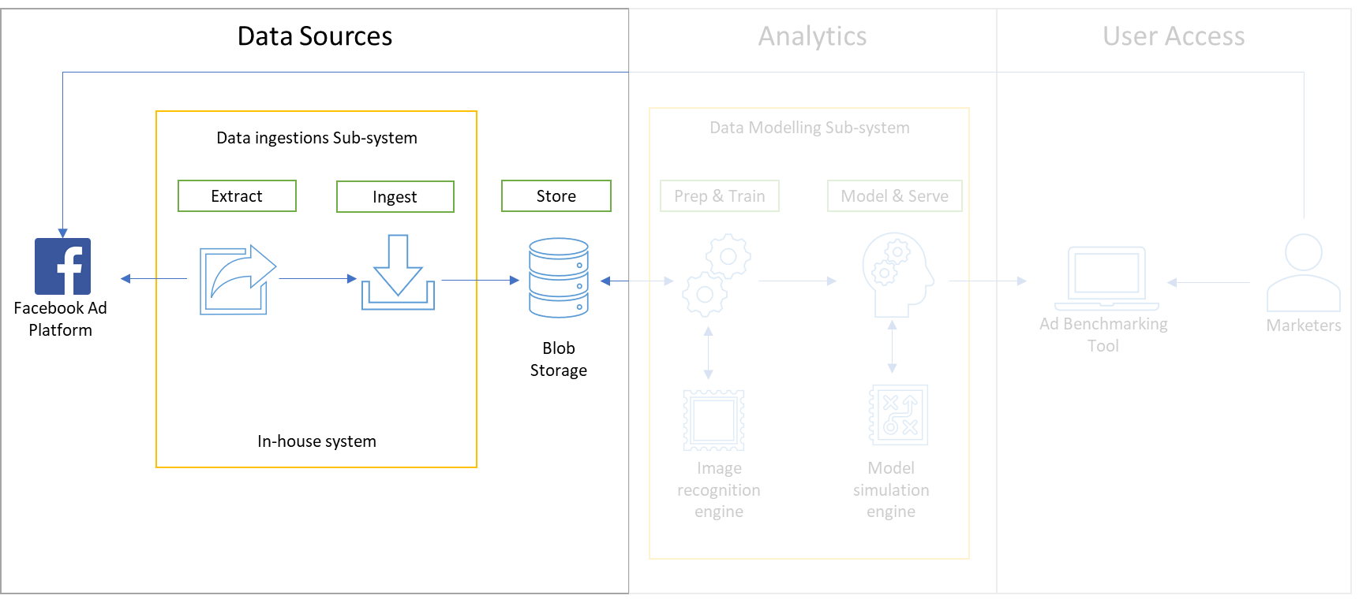
Data Ingestion Sub-system
Intelligence & Technical Architecture

Slide 35
Technical Architecture
Intelligence & Technical Architecture
Data Sources
Analytics
User Access
Data ingestions Sub-system
In-house system
Data Modelling Sub-system
Extract
Ingest
Store
Prep & Train
Model & Serve
Facebook Ad
Platform
Ad Benchmarking
Tool
Marketers
Blob
Storage
Image recognition
engine
Model simulation engine

Slide 36
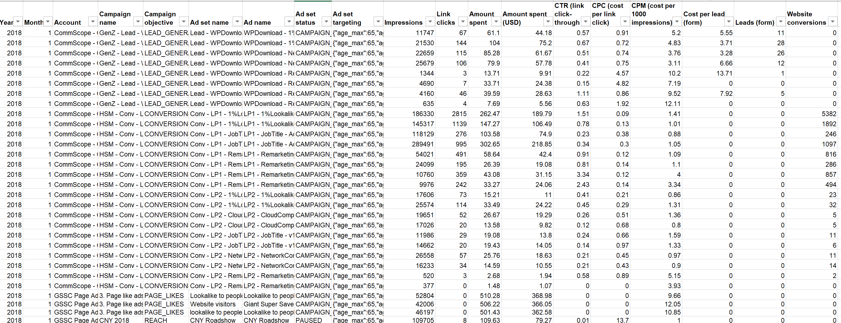

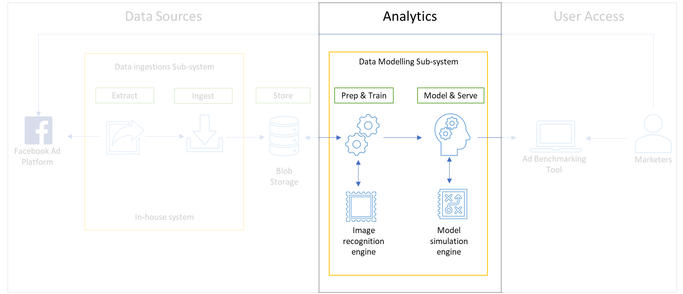
Data Modelling Sub-system
1
Remove Video Ads
Est 2% of dataset
Intelligence & Technical Architecture
Ad Performance
Transform via Python
Data Pre-processing
4
Add Metadata
Industry; company type
2
Select only English ads
3
Break up Targeting into discrete variables
Age; gender country; interests; exclusions;
Data Lake
Extract Ad Features

Slide 37

Data Modelling Sub-system
1
Remove Video Ads
Est 2% of dataset
Intelligence & Technical Architecture
Ad Performance
Transform via Python
Data Pre-processing
4
Add Metadata
Industry; company type
2
Select only English ads
3
Break up Targeting into discrete variables
Age; gender country; interests; exclusions;
Data Lake
Extract Ad Features
Ad Images + Text
5
Extract Ad image features and classify images
6
Extract meaning from body text & headlines

Slide 38
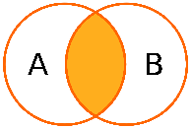
Data Modelling Sub-system
1
Remove Video Ads
Est 2% of dataset
Intelligence & Technical Architecture
Ad Performance
7
Transform via Python
JOIN Ad Performance + Ad Targeting + Ad Images + Text
Data Pre-processing
Model Training
4
Add Metadata
Industry; company type
2
Select only English ads
8
Train and save
the best models
3
Break up Targeting into discrete variables
Age; gender country; interests; exclusions;
Data Lake
Extract Ad Features
Ad Images + Text
5
Extract Ad image features and classify images
9
Models ready to be use by marketers
6
Extract meaning from body text & headlines

Slide 39


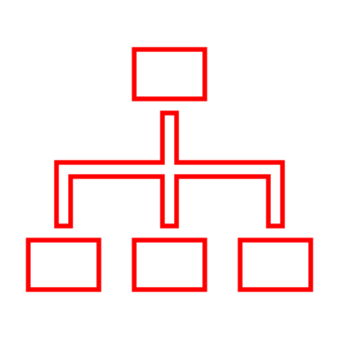
Future Enhancement
Intelligence & Technical Architecture
Data Sources
Analytics
User Access
Data ingestions Sub-system
In-house system
Data Modelling Sub-system
Extract
Ingest
Store
Prep & Train
Model & Serve
Blob
Storage
Ad Benchmarking
Tool with user interface
Marketers
Facebook Ad
Platform
Real time data stream
Image recognition
engine
Model simulation engine
Multi-nodes cluster
Multi-nodes cluster
Enhancements

Slide 40
Thank you | Q&A

Slide 41
Image Feature Extraction & Performance Prediction
Intelligence & Technical Architecture
Image Extraction Supervised Learning Problem Extract image features based on category labels to be inputted. | Prediction Model Supervised Learning Problem Label to work towards: CTR or CPC
Input: image of fixed size (1,200 X 628 px; padded if necessary) Pass this image through a Convolutional Network. The architecture is based on 17 convolution layers. The first convolution layer uses 5 X 5 convolution kernels. Following first layer, there are four groups, and each has four layers with 3 X 3 kernels. The network is pre-trained on a training dataset of category labels Output: Feature vector of the image Note: We would like to do this in an unsupervised learning way in the future as we don’t want to limit the things in the ads | Input: Feature vector of image + Basic feature vector Pass in basic features (e.g. Targeting parameters etc.) into a fully connect layer to reduce dimensionality. Output: a reduced feature vector. Both Image feature vectors and basic feature vectors are passed into a linear regressor. Output: 1 value (CTR)
Source: Deep CTR Prediction in Display Advertising

